Slide 1
Chapter 3- Step Wise: An approach to planning software projects
SOFTWARE
PROJECT MANAGEMENT

Slide 2
‘Step Wise’ - aspirations
Practicality
  tries to answer the question ‘what do I do now?’
Scalability
  useful for small project as well as large
Range of application
Accepted techniques
  e.g. borrowed from PRINCE etc
Notes:
Topics covered
Professional software development
What is meant by software engineering.
Software engineering ethics
A brief introduction to ethical issues that affect software engineering.
Suggested student projects
A brief introduction to each suggested project that can be carried out by students for this course

Slide 3
‘Step Wise’ - an overview
0. Select project
3. Identify project objectives
2. Identify project infrastructure
3. Analyse project characteristics
Review
4. Identify products and activities
Lower level detail
5. Estimate effort for activity
For each activity
6. Identify activity risks
10. Lower level planning
7. Allocate resources
9. Execute plan
8. Review/ publicize plan
Notes:
Topics covered
Professional software development
What is meant by software engineering.
Software engineering ethics
A brief introduction to ethical issues that affect software engineering.
Suggested student projects
A brief introduction to each suggested project that can be carried out by students for this course

Slide 4
A project scenario: Brightmouth College Payroll
College currently has payroll processing carried out by a services company
This is very expensive and does not allow detailed analysis of personnel data to be carried out
Decision made to bring payroll ‘in-house’ by acquiring an ‘off-the-shelf’ application
Notes:
Topics covered
Professional software development
What is meant by software engineering.
Software engineering ethics
A brief introduction to ethical issues that affect software engineering.
Suggested student projects
A brief introduction to each suggested project that can be carried out by students for this course

Slide 5
A project scenario: Brightmouth College Payroll
The use of the off-the-shelf system will require a new, internal, payroll office to be set up
There will be a need to develop some software ‘add-ons’: one will take payroll data and combine it with time-table data to calculate the staff costs for each course run in the college
The project manager is Brigette.
Notes:
Topics covered
Professional software development
What is meant by software engineering.
Software engineering ethics
A brief introduction to ethical issues that affect software engineering.
Suggested student projects
A brief introduction to each suggested project that can be carried out by students for this course

Slide 6
Step 1 establish project scope and objectives
1.1 Identify objectives and measures of effectiveness
  ‘how do we know if we have succeeded?’
1.2 Establish a project authority
  ‘who is the boss?’
1.3 Identify all stakeholders in the project and their interests
  ‘who will be affected/involved in the project?’
Notes:
Topics covered
Professional software development
What is meant by software engineering.
Software engineering ethics
A brief introduction to ethical issues that affect software engineering.
Suggested student projects
A brief introduction to each suggested project that can be carried out by students for this course

Slide 7
Step 1 establish project scope and objectives
1.4 Modify objectives in the light of stakeholder analysis
  ‘do we need to do things to win over stakeholders?’
1.5 Establish methods of communication with all parties
  ‘how do we keep in contact?’
Notes:
Topics covered
Professional software development
What is meant by software engineering.
Software engineering ethics
A brief introduction to ethical issues that affect software engineering.
Suggested student projects
A brief introduction to each suggested project that can be carried out by students for this course

Slide 8
Back to the scenario
Project authority
  Brigette finds she has two different clients for the new system: the finance department and the personnel office. A vice principal agrees to be official client, and monthly meetings are chaired by the VP and attended by Brigette and the heads of finance and personnel
  These meetings would also help overcome communication barriers
Notes:
Topics covered
Professional software development
What is meant by software engineering.
Software engineering ethics
A brief introduction to ethical issues that affect software engineering.
Suggested student projects
A brief introduction to each suggested project that can be carried out by students for this course

Slide 9
Back to the scenario
Stakeholders:
  For example, personnel office would supply details of new staff, leavers and changes (e.g. promotions)
  To motivate co-operation Brigette might ensure new payroll system produces reports that are useful to personnel staff
Notes:
Topics covered
Professional software development
What is meant by software engineering.
Software engineering ethics
A brief introduction to ethical issues that affect software engineering.
Suggested student projects
A brief introduction to each suggested project that can be carried out by students for this course

Slide 10
Step 2 Establish project infrastructure
2.1 Establish link between project and any strategic plan
  ‘why did they want the project?’
2.2 Identify installation standards and procedures
  ‘what standards do we have to follow?’
2.3. Identify project team organization
  ‘where do I fit in?’
Notes:
Topics covered
Professional software development
What is meant by software engineering.
Software engineering ethics
A brief introduction to ethical issues that affect software engineering.
Suggested student projects
A brief introduction to each suggested project that can be carried out by students for this course

Slide 11
Step 3 Analysis of project characteristics
3.1 Distinguish the project as either objective or product-based.
  Is there more than one way of achieving success?
3.2 Analyse other project characteristics (including quality based ones)
  what is different about this project?
Notes:
Topics covered
Professional software development
What is meant by software engineering.
Software engineering ethics
A brief introduction to ethical issues that affect software engineering.
Suggested student projects
A brief introduction to each suggested project that can be carried out by students for this course

Slide 12
Step 3 Analysis of project characteristics
Identify high level project risks
  ‘what could go wrong?’
  ‘what can we do to stop it?’
Take into account user requirements concerning implementation
Select general life cycle approach
  waterfall? Increments? Prototypes?
Review overall resource estimates
  ‘does all this increase the cost?’
Notes:
Topics covered
Professional software development
What is meant by software engineering.
Software engineering ethics
A brief introduction to ethical issues that affect software engineering.
Suggested student projects
A brief introduction to each suggested project that can be carried out by students for this course

Slide 13
Back to the scenario
Objectives vs. products
  An objective-based approach has been adopted
Some risks
  There may not be an off-the-shelf package that caters for the way payroll is processed at Brightmouth College
Answer?
  Brigette decides to obtain details of how main candidate packages work as soon as possible; also agreement that if necessary processes will be changed to fit in with new system
Notes:
Topics covered
Professional software development
What is meant by software engineering.
Software engineering ethics
A brief introduction to ethical issues that affect software engineering.
Suggested student projects
A brief introduction to each suggested project that can be carried out by students for this course

Slide 14
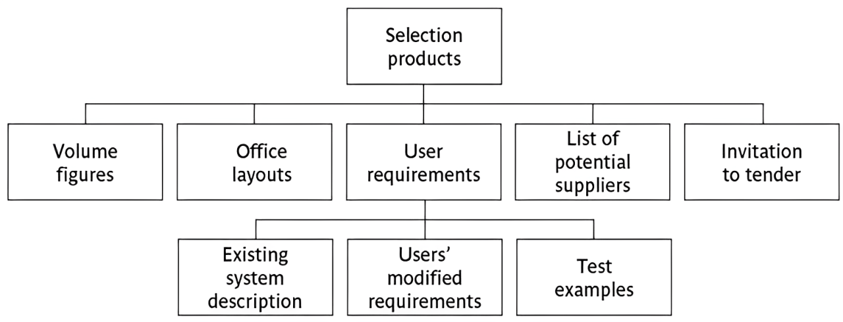
Step 4 Identify project products and activities
4.1 Identify and describe project products - ‘what do we have to produce?’
Notes:
Topics covered
Professional software development
What is meant by software engineering.
Software engineering ethics
A brief introduction to ethical issues that affect software engineering.
Suggested student projects
A brief introduction to each suggested project that can be carried out by students for this course

Slide 15
Products
The result of an activity
Could be (among other things)
  physical thing (‘installed pc’),
  a document (‘logical data structure’)
  a person (‘trained user’)
  a new version of an old product (‘updated software’)
Notes:
Topics covered
Professional software development
What is meant by software engineering.
Software engineering ethics
A brief introduction to ethical issues that affect software engineering.
Suggested student projects
A brief introduction to each suggested project that can be carried out by students for this course

Slide 16
Products
The following are NOT normally products:
  activities (e.g. ‘training’)
  events (e.g. ‘interviews completed’)
  resources and actors (e.g. ‘software developer’) - may be exceptions to this
Products CAN BE deliverable or intermediate
Notes:
Topics covered
Professional software development
What is meant by software engineering.
Software engineering ethics
A brief introduction to ethical issues that affect software engineering.
Suggested student projects
A brief introduction to each suggested project that can be carried out by students for this course

Slide 17
Product description (PD)
Product identity
Description - what is it?
Derivation - what is it based on?
Composition - what does it contain?
Format
Relevant standards
Quality criteria
Create a PD for ‘test data’
Notes:
Topics covered
Professional software development
What is meant by software engineering.
Software engineering ethics
A brief introduction to ethical issues that affect software engineering.
Suggested student projects
A brief introduction to each suggested project that can be carried out by students for this course

Slide 18
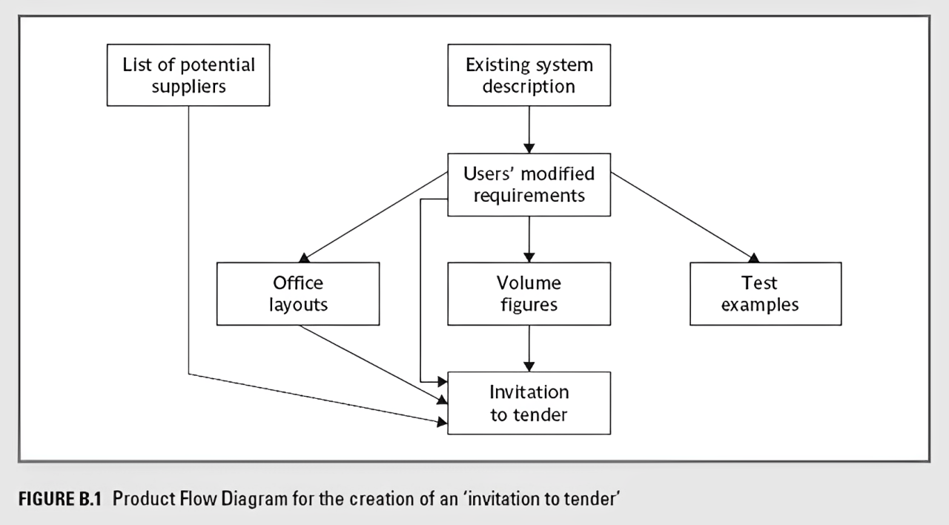
Step 4 continued
4.2 document generic
product flows
Notes:
Topics covered
Professional software development
What is meant by software engineering.
Software engineering ethics
A brief introduction to ethical issues that affect software engineering.
Suggested student projects
A brief introduction to each suggested project that can be carried out by students for this course

Slide 19
Step 4.3 Recognize product instances
The PBS and PFD will probably have identified generic products e.g. ‘software modules’
It might be possible to identify specific instances e.g. ‘module A’, ‘module B’ …
But in many cases this will have to be left to later, more detailed, planning
Notes:
Topics covered
Professional software development
What is meant by software engineering.
Software engineering ethics
A brief introduction to ethical issues that affect software engineering.
Suggested student projects
A brief introduction to each suggested project that can be carried out by students for this course

Slide 20
Step 4.4. Produce ideal activity network
Identify the activities needed to create each product in the PFD
More than one activity might be needed to create a single product
Hint: Identify activities by verb + noun but avoid ‘produce…’ (too vague)
Draw up activity network
Notes:
Topics covered
Professional software development
What is meant by software engineering.
Software engineering ethics
A brief introduction to ethical issues that affect software engineering.
Suggested student projects
A brief introduction to each suggested project that can be carried out by students for this course

Slide 21
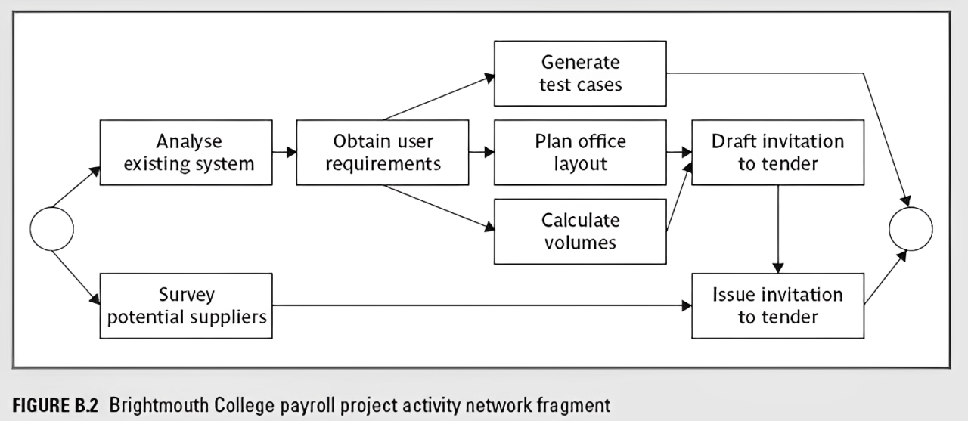
An ‘ideal’ activity
Notes:
Topics covered
Professional software development
What is meant by software engineering.
Software engineering ethics
A brief introduction to ethical issues that affect software engineering.
Suggested student projects
A brief introduction to each suggested project that can be carried out by students for this course

Slide 22
Step 4.5 Add check-points if needed
Design module A
Code module A
Design system
Design module B
Code module B
Test system
Design module C
Code module C
Put in a check point
Design module A
Code module A
Design system
Design module B
Check-point
Code module B
Test system
Design module C
Code module C
Notes:
Topics covered
Professional software development
What is meant by software engineering.
Software engineering ethics
A brief introduction to ethical issues that affect software engineering.
Suggested student projects
A brief introduction to each suggested project that can be carried out by students for this course

Slide 23
Step 5:Estimate effort for each activity
5.1 Carry out bottom-up estimates
  distinguish carefully between effort and elapsed time
5.2. Revise plan to create controllable activities
  break up very long activities into a series of smaller ones
  bundle up very short activities (create check lists?)
Notes:
Topics covered
Professional software development
What is meant by software engineering.
Software engineering ethics
A brief introduction to ethical issues that affect software engineering.
Suggested student projects
A brief introduction to each suggested project that can be carried out by students for this course

Slide 24
Step 6: Identify activity risks
6.1 Identify and quantify risks for activities
  damage if risk occurs (measure in time lost or money)
  likelihood if risk occurring
6.2 Plan risk reduction and contingency measures
  risk reduction: activity to stop risk occurring
  contingency: action if risk does occur
6.3 Adjust overall plans and estimates to take account of risks
  e.g. add new activities which reduce risks associated with other activities e.g. training, pilot trials, information gathering
Notes:
Topics covered
Professional software development
What is meant by software engineering.
Software engineering ethics
A brief introduction to ethical issues that affect software engineering.
Suggested student projects
A brief introduction to each suggested project that can be carried out by students for this course

Slide 25
Step 7: Allocate resources
7.1 Identify and allocate resources to activities
7.2 Revise plans and estimates to take into account resource constraints
  e.g. staff not being available until a later date
  non-project activities
Notes:
Topics covered
Professional software development
What is meant by software engineering.
Software engineering ethics
A brief introduction to ethical issues that affect software engineering.
Suggested student projects
A brief introduction to each suggested project that can be carried out by students for this course

Slide 26
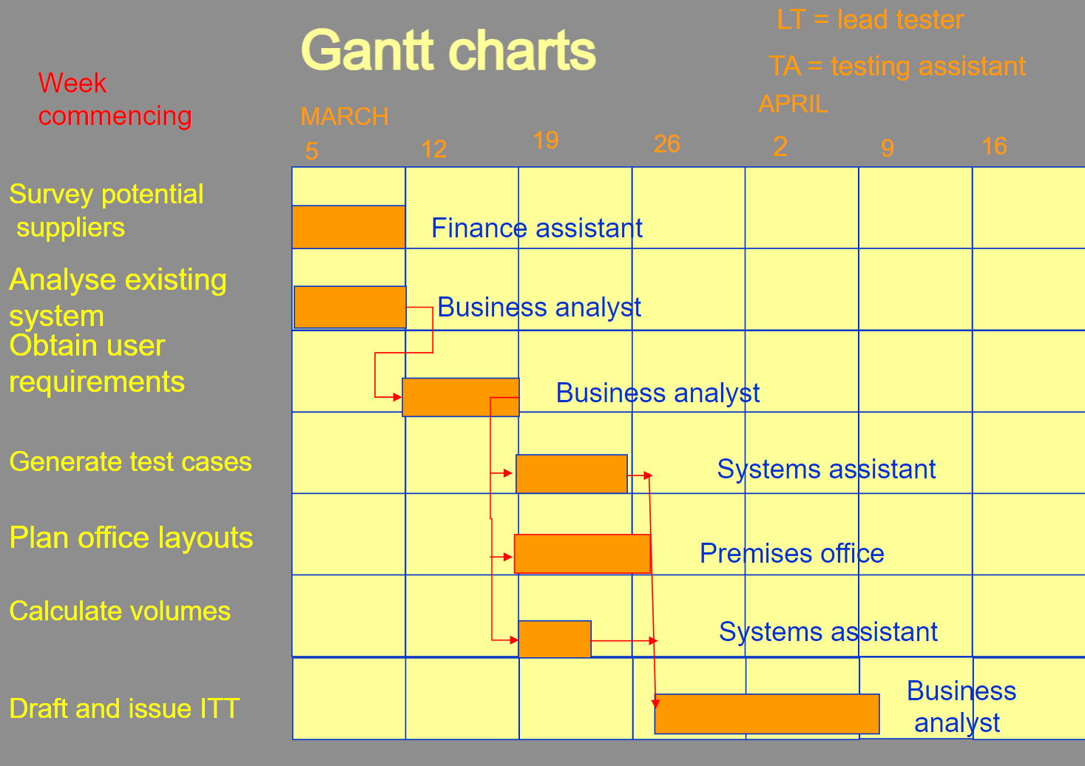
Gantt charts
Notes:
Topics covered
Professional software development
What is meant by software engineering.
Software engineering ethics
A brief introduction to ethical issues that affect software engineering.
Suggested student projects
A brief introduction to each suggested project that can be carried out by students for this course

Slide 27

Step 8: Review/publicise plan
8.1 Review quality aspects of project plan
8.2 Document plan and obtain agreement
Step 9: Execute plan
Step 10: create lower level plans
Notes:
Topics covered
Professional software development
What is meant by software engineering.
Software engineering ethics
A brief introduction to ethical issues that affect software engineering.
Suggested student projects
A brief introduction to each suggested project that can be carried out by students for this course

Slide 28
Key points
Establish your objectives
Think about the characteristics of the project
Discover/set up the infrastructure to support the project (including standards)
Identify products to be created and the activities that will create them
Allocate resources
Set up quality processes
Notes:
Topics covered
Professional software development
What is meant by software engineering.
Software engineering ethics
A brief introduction to ethical issues that affect software engineering.
Suggested student projects
A brief introduction to each suggested project that can be carried out by students for this course

